Slide 1
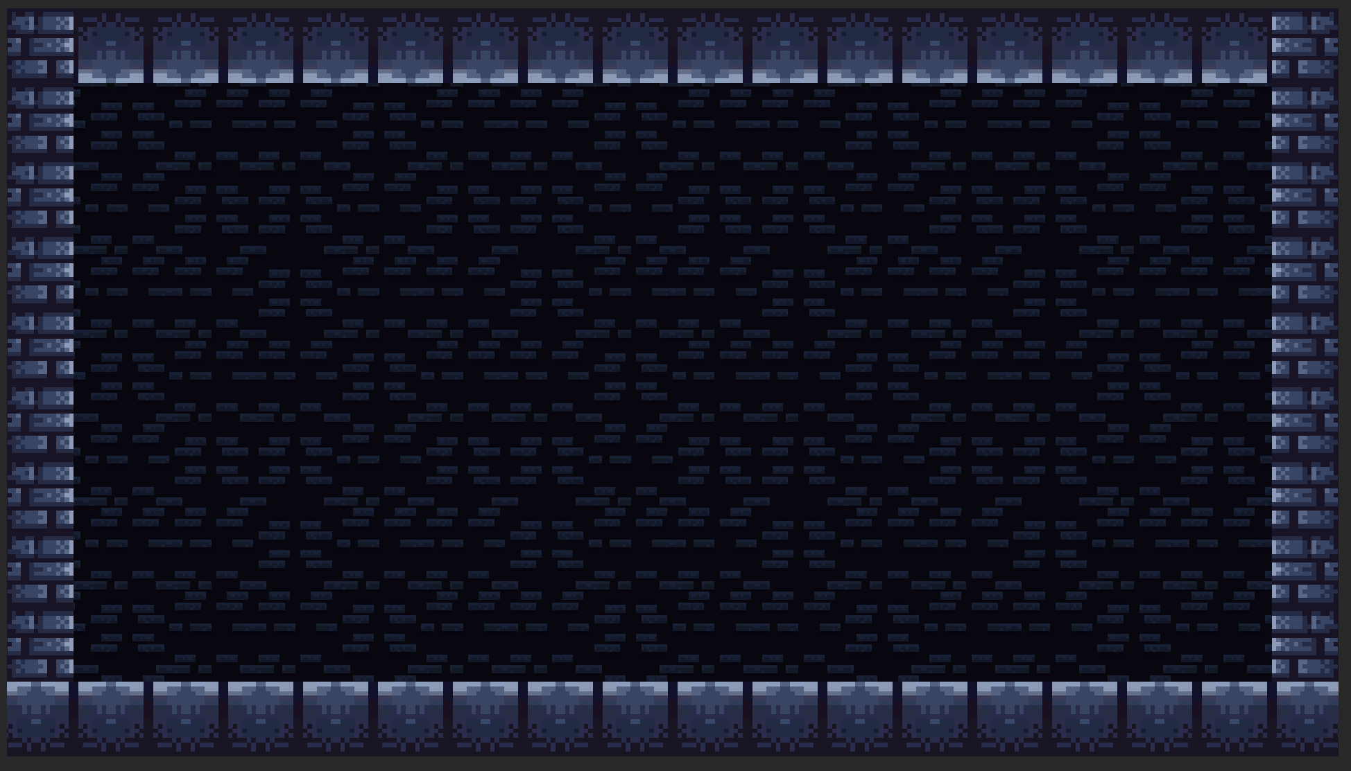


From Coeur d’Game

Slide 2
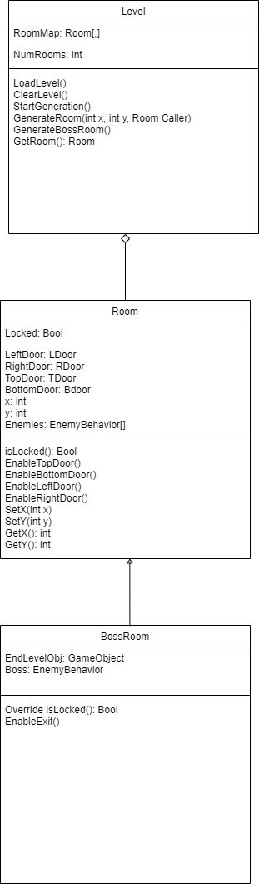
Prototype Pattern
Main Idea: Create a prototype system to easily copy or clone a particular object. Usually using a Clone() function or similar.
Perfectly suited my needs for the level generator because each room is a copy of the same configurable object.
Good for programs that need to create a lot of the same object.
Bad for programs that need extremely varied objects.

Slide 3
Modular Room Prefabs
Rogue-Realm\Docs\Jacob Porath\Prefab\
- Modular Room Prefabs.docx - Documentation
- Room Prefab Showcase.mp4 - Preview of the Room Prefab

Slide 4
Copyright
The level generator of Rogue Realm uses art from a tileset available from itch.io. The tileset is an artistic, creative work. Therefore, it is protected by copyright.
However, I can argue my right to use it based on the transformative nature of the work I’ve done with it.
I have transformed it from a set of dungeon themed tiles and artwork into a video game. I have edited the work to better fit my purpose and used it to create something completely different from itself. In short, my work is transformative enough that I should be able to use it.

Slide 5
Ethics in Software Engineering
Public - Act consistent with public interest.
Client & Employer - Act in best interest of clients and employers.
Product - Ensure products and work meet highest possible standards.
Judgement - Maintain integrity and independence in professional judgement.
Management - Support an ethical approach to management.
Profession - Advance the integrity and reputation of the profession.
Colleagues - Be fair and supportive of colleagues.
Self - Embrace lifelong learning in the practice of the profession.

